Slide 1
LENDING CLUB CASE STUDY SUBMISSION
Group Members:
Karthik M Nair
Hiep V Dang

Slide 2
PROBLEM STATEMENT
A consumer finance company which specialises in lending various
types of loans to urban customers, receives a loan application, the
company has to make a decision for loan approval based on the
applicant’s profile.
Two types of risks are associated with the bank’s decision:
1. If the applicant is likely to repay the loan, then not approving
the loan results in a loss of business to the company.
2. If the applicant is not likely to repay the loan, i.e. he/she is
likely to default, then approving the loan may lead to a
financial loss for the company.

Slide 3
DATA SET

Slide 4
When a person applies for a loan, there are two types of decisions
that could be taken by the company:
Loan accepted: If the company approves the loan, there are 3 possible scenarios
described below:
1.Fully paid: Applicant has fully paid the loan (the principal and the interest
rate)
2.Current: Applicant is in the process of paying the instalments, i.e. the tenure
of the loan is not yet completed. These candidates are not labelled as 'defaulted'.
3.Charged-off: Applicant has not paid the instalments in due time for a long
period of time, i.e. he/she has defaulted on the loan.
Loan rejected: The company had rejected the loan (because the candidate does not
meet their requirements etc.).

Slide 5
CASE STUDY OBJECTIVE
Identify the risky loan applicants whom are tend to ‘default/charged of’
Understand the driving factors or Driver Variables behind Loan Default
Lending company can utilise this analysis for its portfolio and risk assessment

Slide 6
Problem solving methodology
> Drop columns with null values,
all random values or single
category value
> Convert values to proper int,
float, date representations
> Analyse variables against
segments of other variables
> Create derived variables
Publish insights and
observations
Clean Data
Univariate Analysis
Segmented Univariate Analysis
Bivariate Analysis
Summarize Results
> Check distributions and
frequencies of various numerical
and categorical variables
> Create derived variables
> Do correlation analysis
Check how two variables affect
each other or a third variable
> Analyse joint distributions

Slide 7
ANALYSIS
The essence of the whole project is to analyze and understand how consumer attributes and loan
attributes are influencing the tendency of defaulting.
● We performed data cleaning and preparation on the Loan dataset:
○ Imputed the NA values for all the variables
○ Created two new columns:
■ Profit and Loss column
■ Ratio of funded amount and annual income
● During univariate analysis we have created:
○ Histograms and Bar charts to check out the distribution of all the driver variables
○ Box plots to detect the Outliers
○ Performed the Multivariate analysis to understand how different variables interact with each
other.

Slide 8
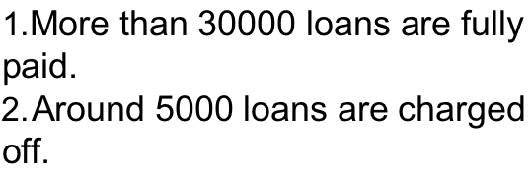
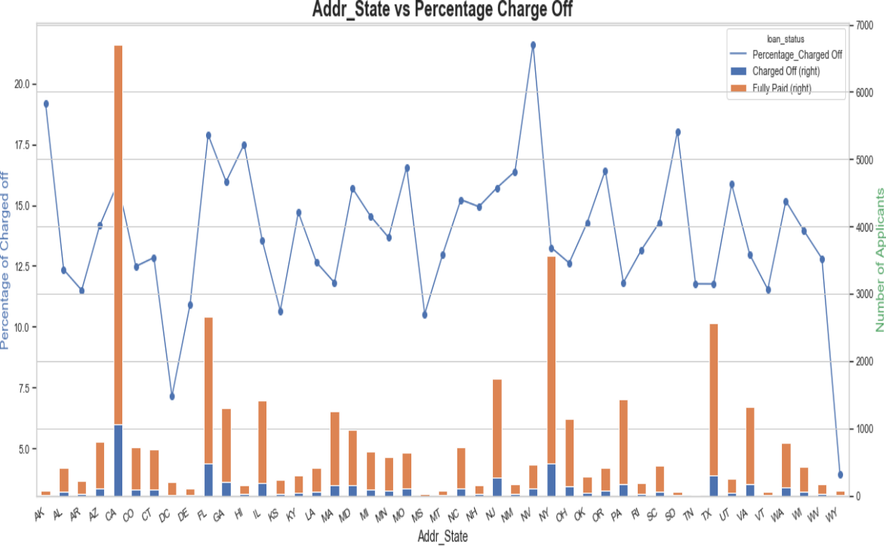
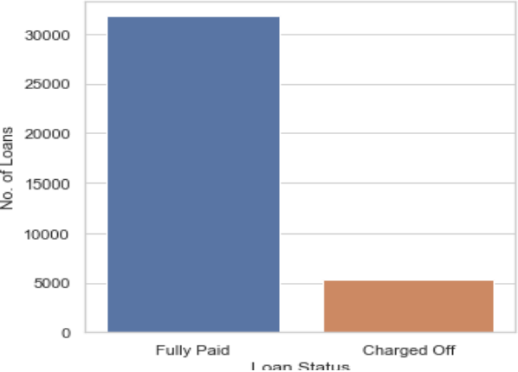
Loan Status Analysis
1.Maximum no. of loans are applied by people from CA.
2.Maximum no. of loans are charged off for people of NV.

Slide 9
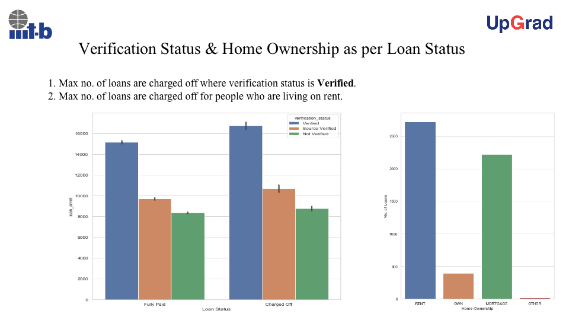

Slide 10
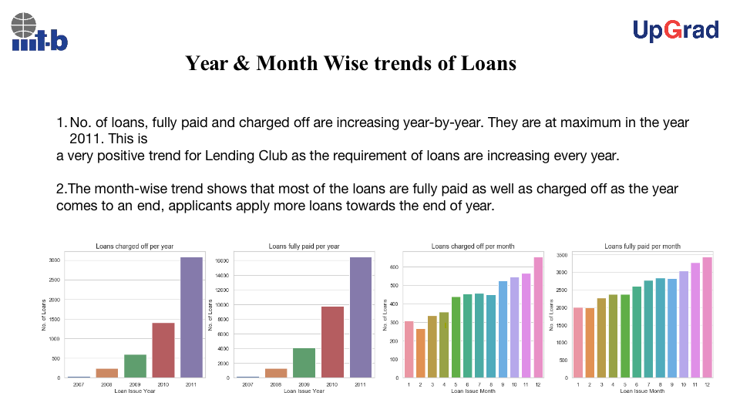
Loan Applicants work Experience Analysis

Slide 11
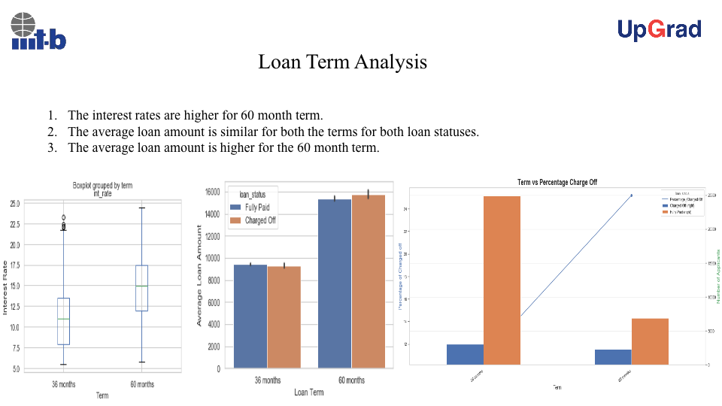
Loan Amount Analysis

Slide 12
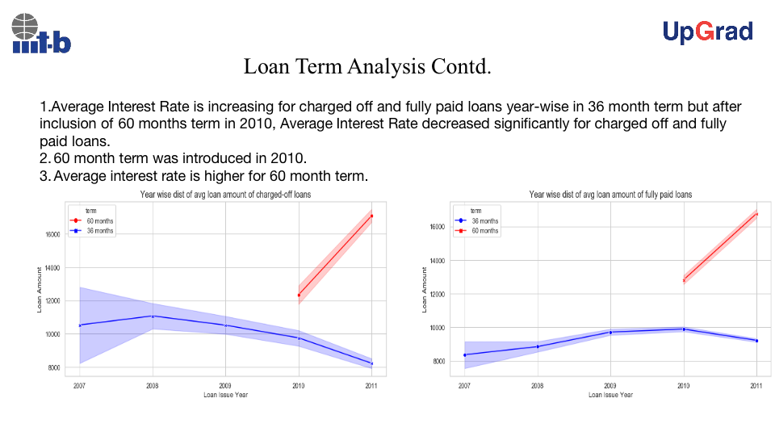
Income Analysis for the loan applicants

Slide 13
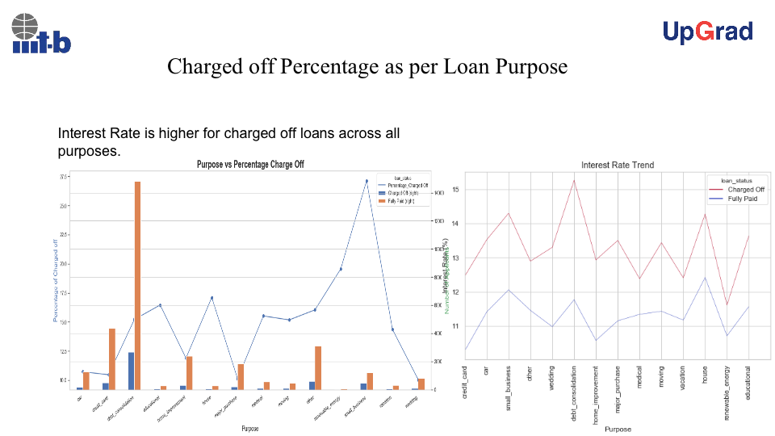
Loan Defaulters by State Analysis

Slide 14
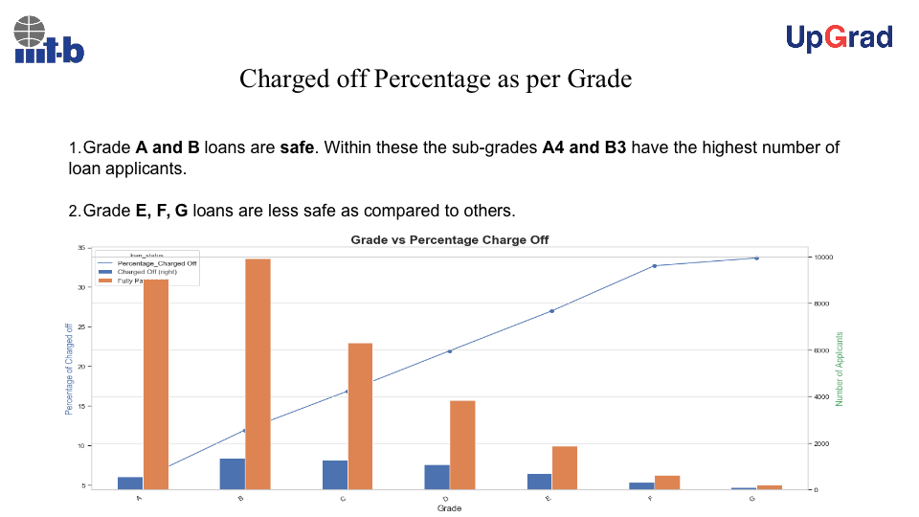
Purpose for applying Loan Analysis

Slide 15
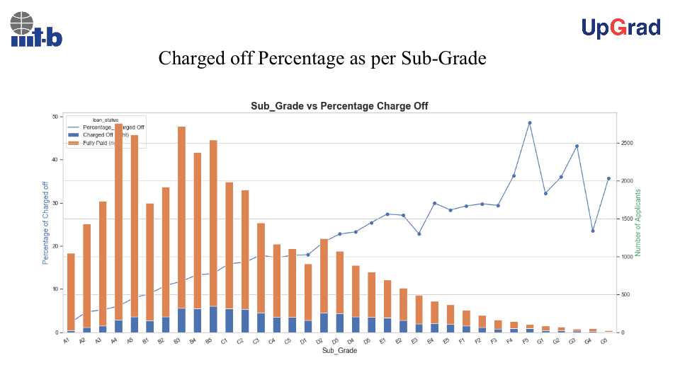
Loan Status vs Loan Tenure

Slide 16
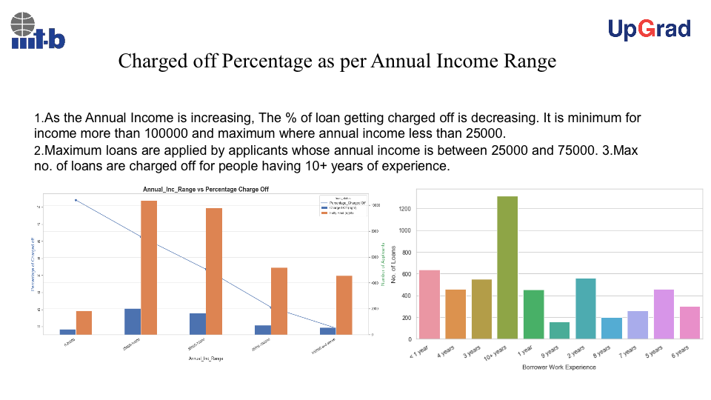
Conclusion
Results
1. Low grade loans have high tendency to default.
Grading system is working as expected.
2. Loans having higher interest rate have more
defaulters. Check the background of applicant
thoroughly if interest rate is high.
3. Extra scrutiny must be done for the applicants
belonging to CA state, as tendency to default is
high.
4. When the purpose is debt consolidation check
applicant thoroughly as it has high tendency to
default.

Slide 17
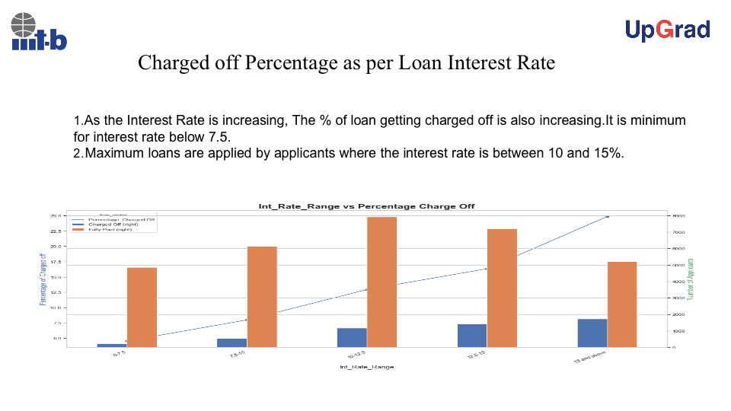
Conclusion
Results
1. Low grade loans have high tendency to default.
Grading system is working as expected.
2. Loans having higher interest rate have more
defaulters. Check the background of applicant
thoroughly if interest rate is high.
3. Extra scrutiny must be done for the applicants
belonging to CA state, as tendency to default is
high.
4. When the purpose is debt consolidation check
applicant thoroughly as it has high tendency to
default.

Slide 18
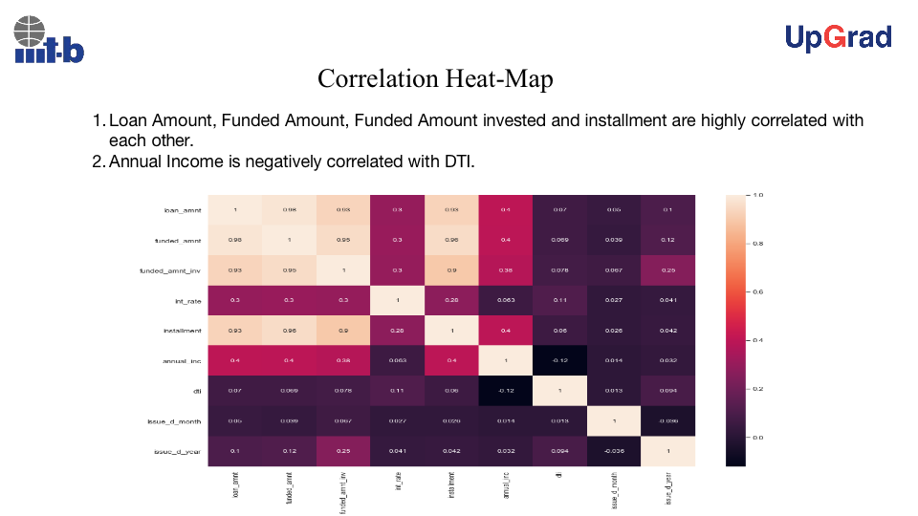
Conclusion
Results
1. Low grade loans have high tendency to default.
Grading system is working as expected.
2. Loans having higher interest rate have more
defaulters. Check the background of applicant
thoroughly if interest rate is high.
3. Extra scrutiny must be done for the applicants
belonging to CA state, as tendency to default is
high.
4. When the purpose is debt consolidation check
applicant thoroughly as it has high tendency to
default.

Slide 19
Conclusion
1. Lending Club should be wary of the loans where the purpose is **Small Business** as the percentage of a loan being charged off is maximum **27.1%**. Accepting loans for the purpose of **Weddings, major purchase, car and credit card** is highly recommended.
2. Higher the loan amount, the higher the chances of loan being charged off. Therefore Lending Company should consider accepting loans of lower amount. The maximum no. of loans, **12410** are applied where the **loan amount** ranges between 5000 and 10000. For this range the probability of the the loan getting charged off is very less. Hence the risk factor is low for lending club.
3. Lending Club should consider accepting more loans from applicants whose annual income is **greater than 100000** as their probability of charge off is minimum.
4. Lending Club should consider accepting more loans where interest rate is **less than 7.5%** as their probability of charge off is minimum.
5. Lending Club should consider accepting more loans of grade **A and B**. It should be cautious of loans falling in grades **E,F and G**
6. Lending Club should consider accepting more loans from people who **owns** a house.
7. The number of loan applicants are increasing with each passing year bringing more business to Lending Club which is leading to more loans getting accepted as well as more loans getting charged off. Moreover the last few months of the year are quite critical as most of the loans are either fully paid or charged off at that time.
8. Lending Club should accept more loans for the term of **36 months** as the % of charged off loans is less and the no. of loan applicants are more. Also the avg fully paid loan amount is increasing over the years and avg charged off lon amount is decreasing over the years.

